Slide 1
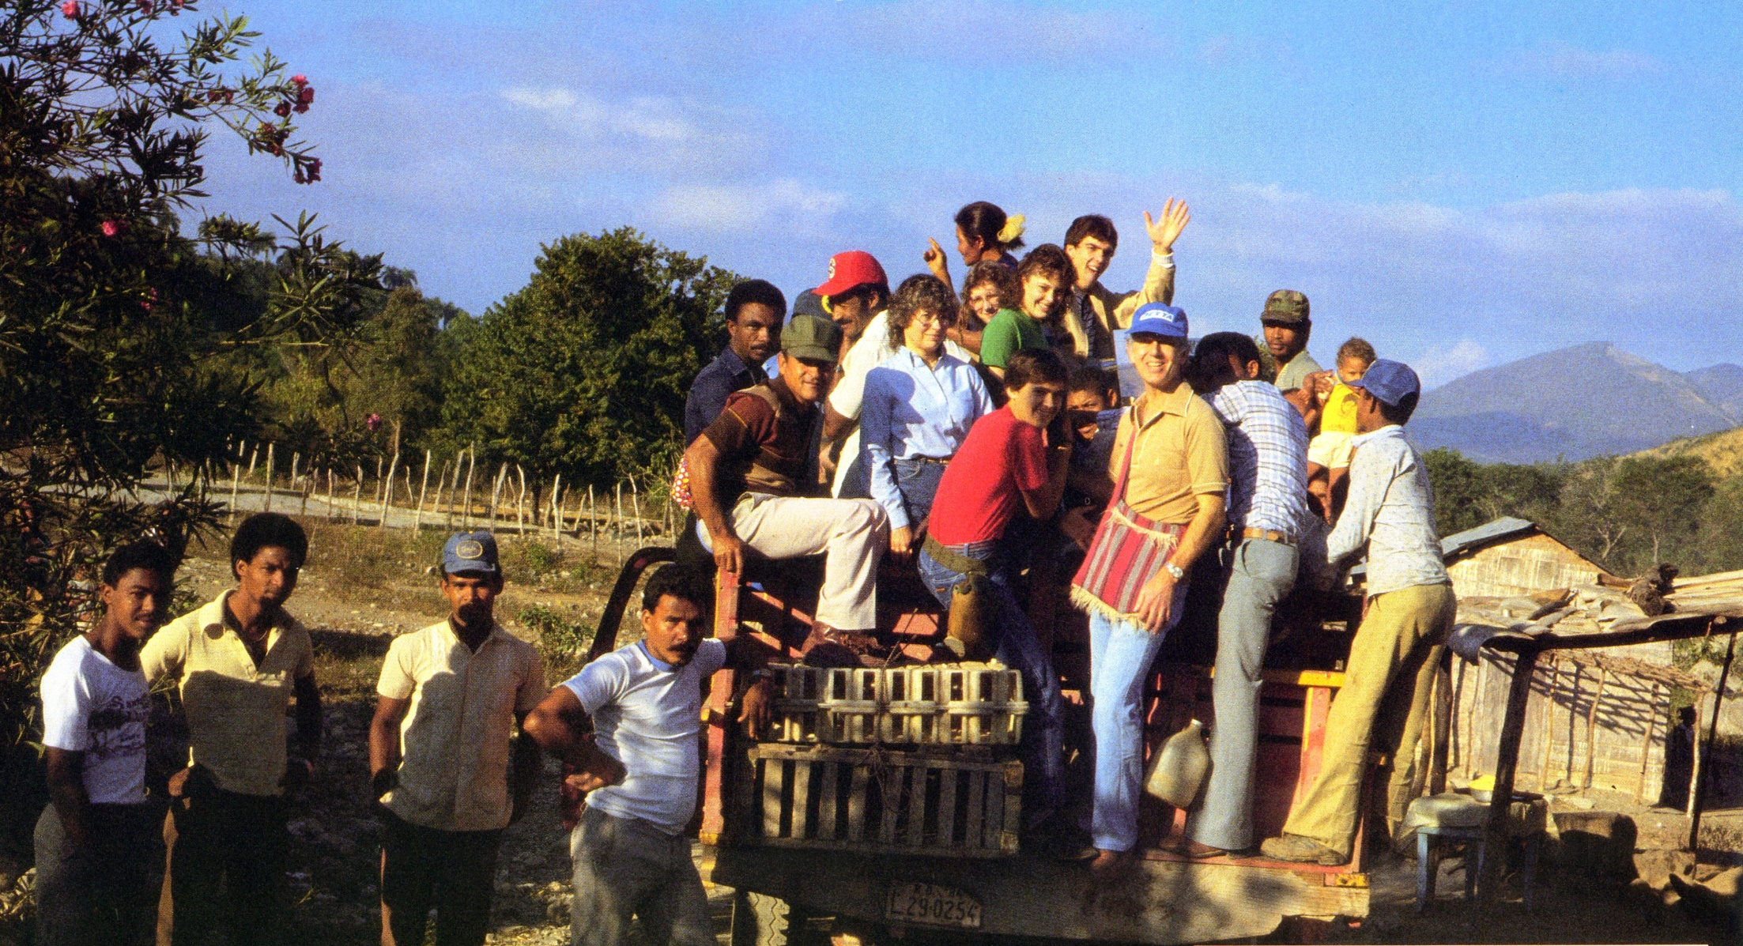
Medical Practicum: 1981-2016

Slide 2
Outline
How it started
Sites
  Requirements
  Selection
Evolution of trip
Outcomes
  Communities served
  Participants
Ideas for future

Slide 3
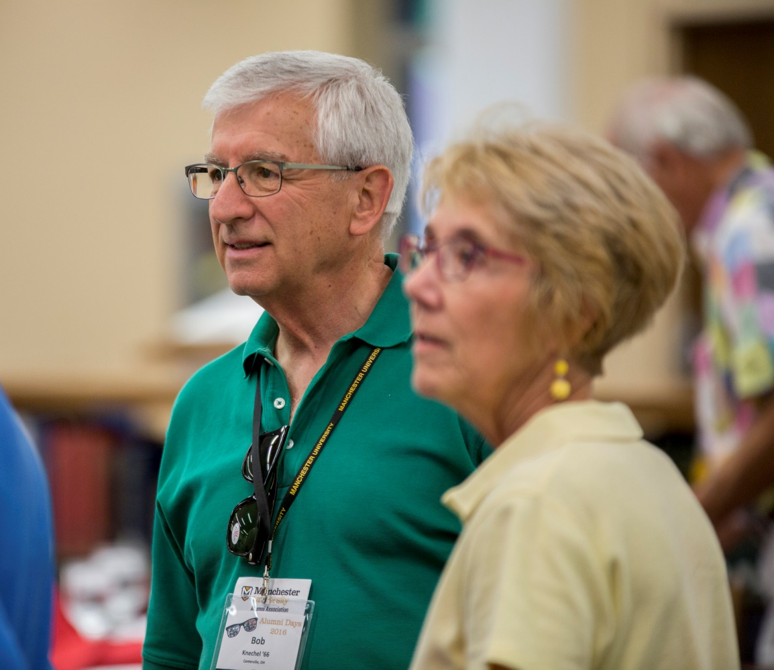
The Beginning
Fall of 1979
Fred LaMar
DePauw U. Chaplain
5D_27998 by Manchester University
Bob Knechel
MC Campus Pastor
Notes:
Bob got call from Fred LaMar re recent Jan term program at DePauw
Team of nursing students serving in rural clinics in C.A. during Jan Term. Many opportunities
Would Manchester consider a similar program? And I was offered opportunity plan and direct the course.

Slide 4
Why did I accept?
International Education
Programs for Science Majors
Strength in Health Sciences
Mission Statement
International Experience
Notes:
International Education was being emphasized at MU. There were no programs designed for science majors. An experience like this fit well with our strengths in the health sciences. The proposed course aptly fulfilled the University mission of Faith, Learning, and Service. And I had international experience

Slide 5
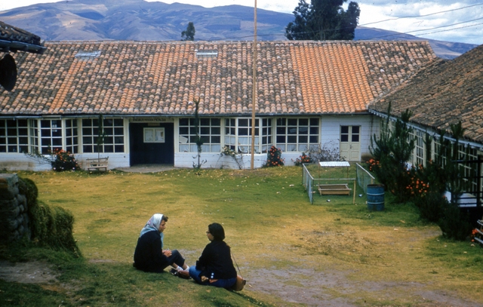
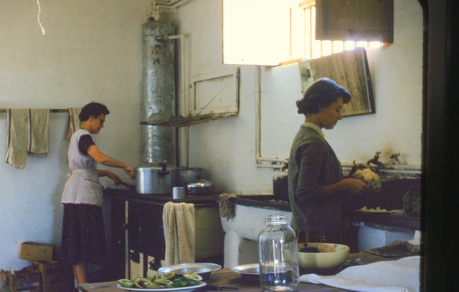
6 Weeks Work Camp in Rural Ecuador in 1956
“Camping” in a school using pit latrine
New foods
Notes:
Martha and I had international experience: 6 weeks work camp in rural Ecuador in 1956
1st time to taste avocados (on plate in foreground), many new delicious fruits

Slide 6
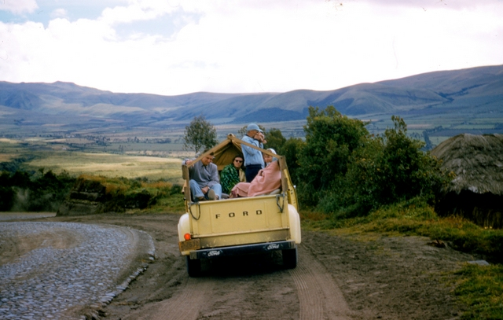
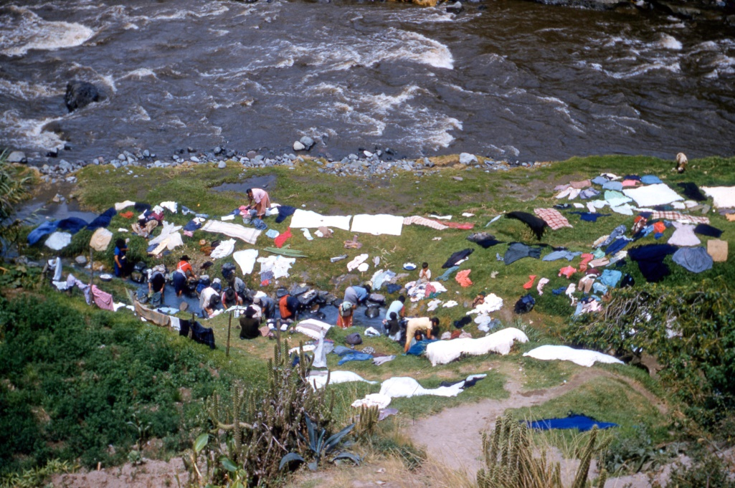
Over high mountain passes
Down to Amazon headwaters
Notes:
Traveled over dirt roads, got covered with dust, Saw how laundry was done in much of the world.
How ours was done 25 years later on Med Pract. trips

Slide 7
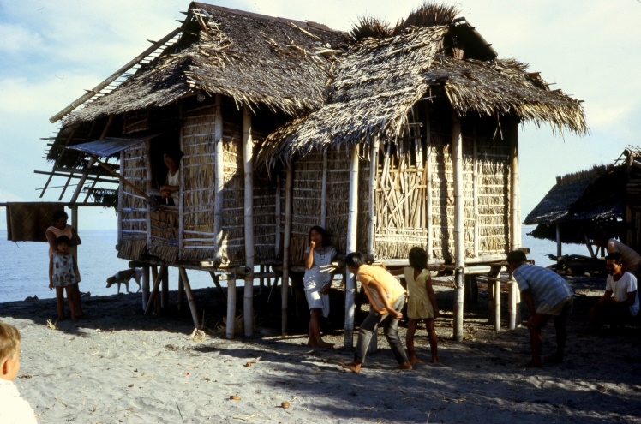
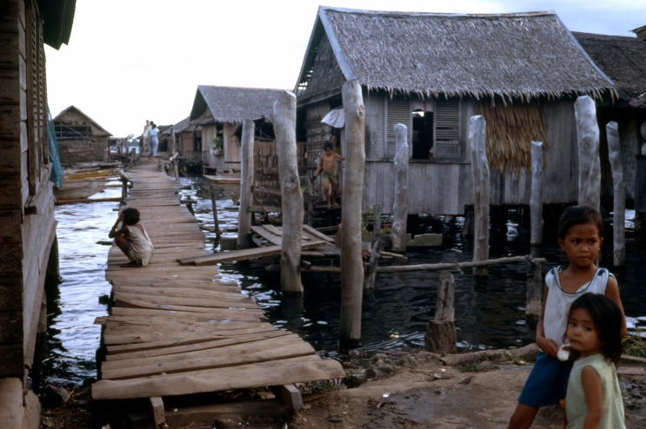
Sabbatical Year in Rural Philippines 1971-72
Encountering different cultures
Notes:
A sabbatical year at Silliman University in rural Philippines 1971-72
followed by 3 months of travel on our own through Asia and Europe (with children ages 8 and 11)
Fisherman’s hut near Dumaguete, Moro village near Zamboanga southern Mindanao

Slide 8
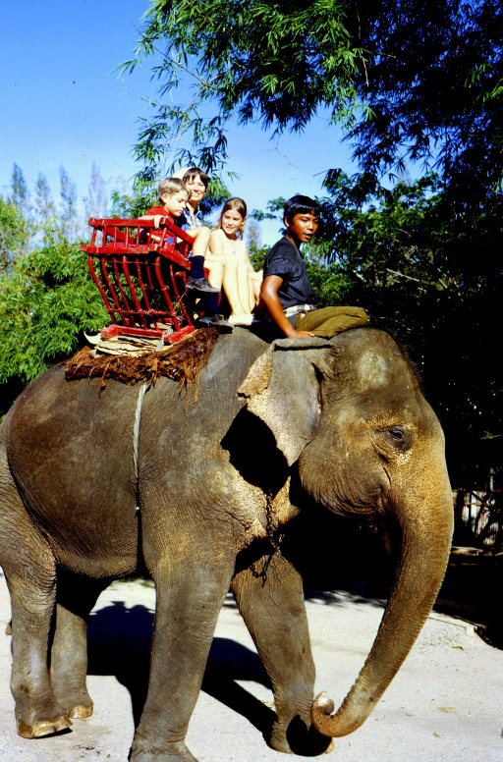
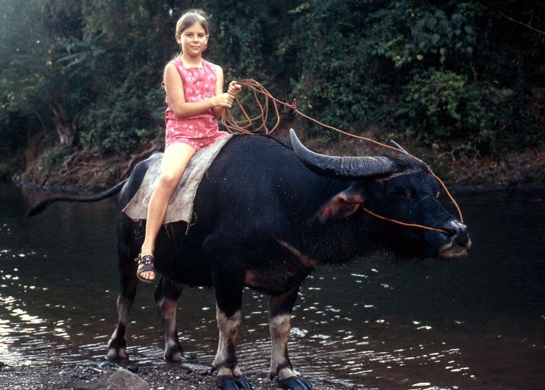
New modes of transportation
Notes:
Caraboa (water buffalo): ride, pull oxcart, milk
Buddhist society in Thailand

Slide 9
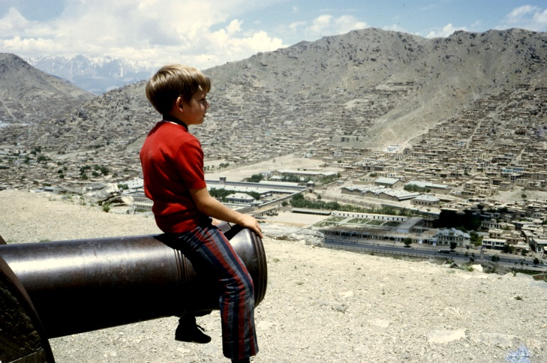
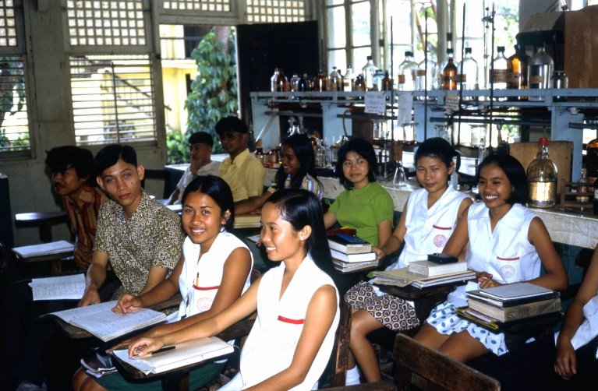
Islamic society
Organic chemistry class with different cultural assumptions
Notes:
Overlooking Kabul. Capital of Afghanistan. 1st time to see women in burkhas
Cultures where saying “no” to someone is impolite. Learned that “maybe” really was “no”

Slide 10
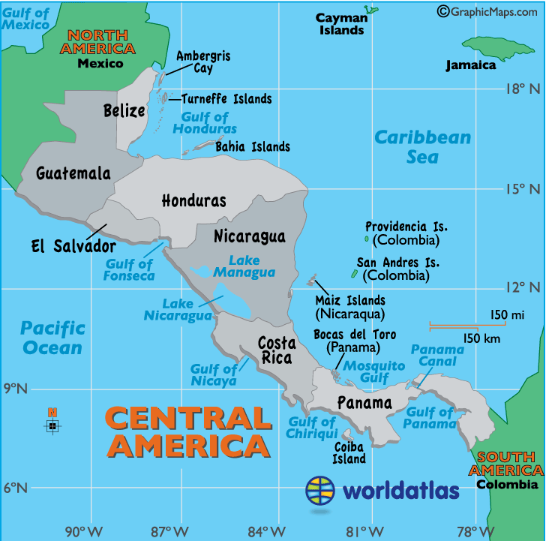
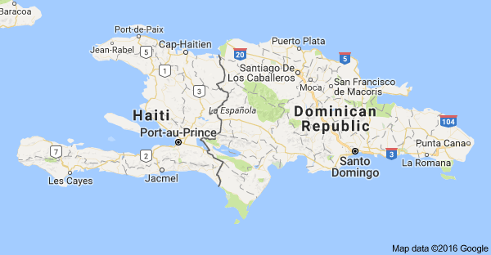
Medical
Practicum
Locations
4
1
3
6
5
2
worldatlas.com/webimage/
countrys/camerica.htm
Notes:
Where has the Medical Practicum served?

Slide 11
Location Requirements
1. Permission for entering country.
2. Support and facilities at locale.
3. High health care need.
4. Cultural experience for students.
Notes:
Cultural experiences: foreign language, in the minority, pit latrines, bathing in rivers, no electricity, no cellphone towers, no TV, etc.

Slide 12
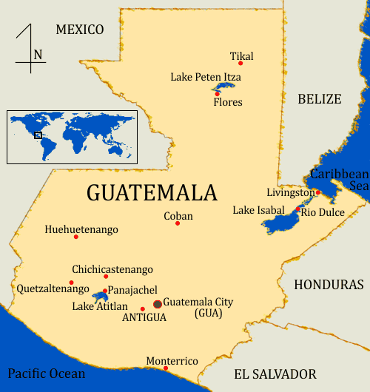
1981
Episcopal church
*
Mariscos
www.visit-antigua.com
Notes:
How where sites chosen?
First 3 years: where DePauw had worked and contacts were in place. All were with religious organizations with facilities available for groups and a local supporting community. 1980 was before fax, internet, and email. All communication was by telephone and snail mail. Doctors licenses, lists of meds, names of participants, etc., had to be mailed early. Most offices in C.A. closed for Christmas the week before and opened after New Year’s Day.
1. Guatemala: Episcopal church in Guatemala City and local parish in Mariscos on Lago Izabal.
By commercial bus to Mariscos and were introduced to local military since civil war was just winding
down.

Slide 13
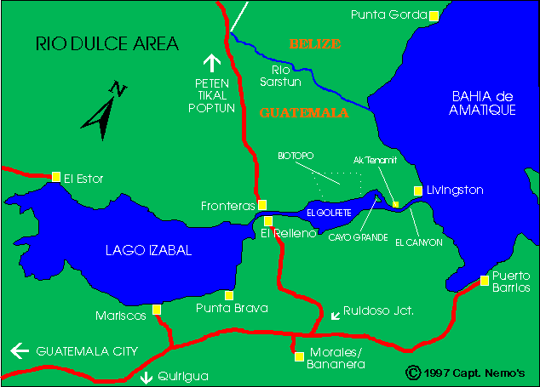
*
San Felipe
*
Boca Ancha
Izabal
*
*
Cruce Virginia
mayaparadise.com/
riomap1.htm
Notes:
Day clinic in Izabal, 3 day trip to Punta Brava, Boca Ancha and San Felipe. 13 in cayuco with meds, sleeping bags, etc.

Slide 14
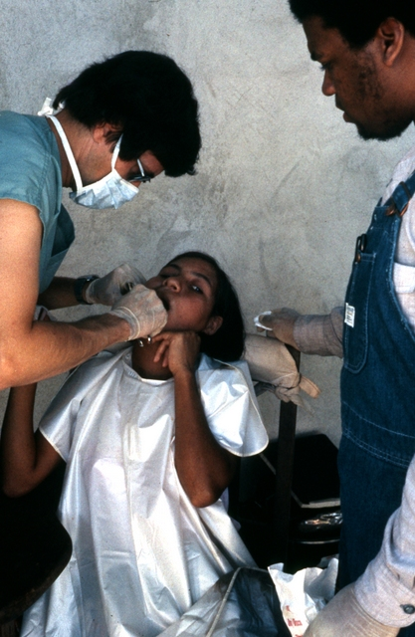
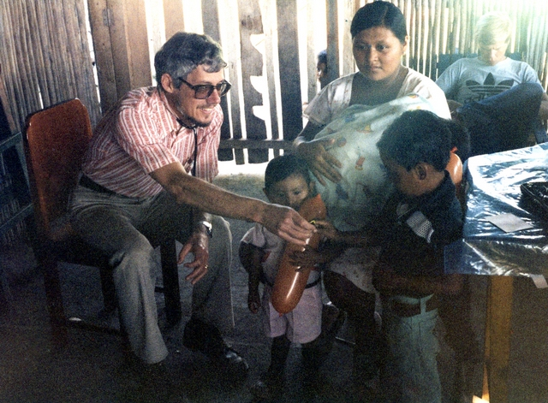
Medical Professionals
Rick Myers, DDS, ‘69
Don Parker, MD, ‘56
Notes:
Era before digital cameras, All pictures through 2003 are scanned from slides or prints, resolution not high.
Hundreds more prints and slides yet to scan.

Slide 15
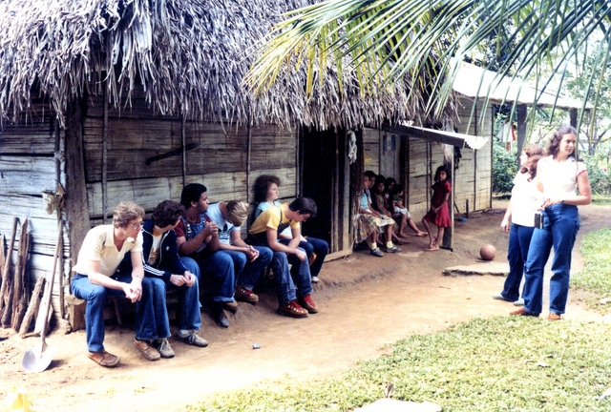
Dan Nordman, Rex Flenar, Hank Grimes, Tim Troyer, Pete Grieser, Suzanne Shenk
Rachel Callaway, Gladys Stutzman
Notes:
Students: Dan, MD Indianapolis, IN, pain management specialist; Rex, MD Ft Wayne, IN, Family medicine; Hank, transfer to IU Bloomington, major in modern foreign language, same in grad school. Great facility for language;
Tim, MD Atlanta, GA ; Pete, DDS Tacoma, WA; Suzanne, MD Trenton, NJ; Rachel, Pharmaceutical rep, Bloomington, IN; Gladys, Medical technologist, Fishers, IN How long has the Med Pract. Been in existence:. These students are now in their mid-50’s

Slide 16
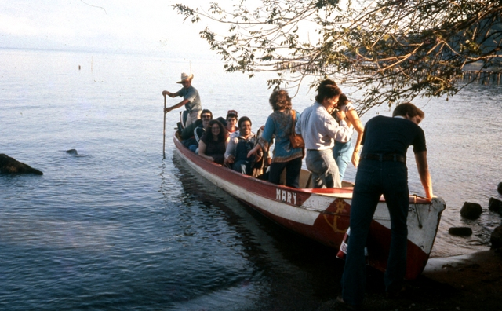
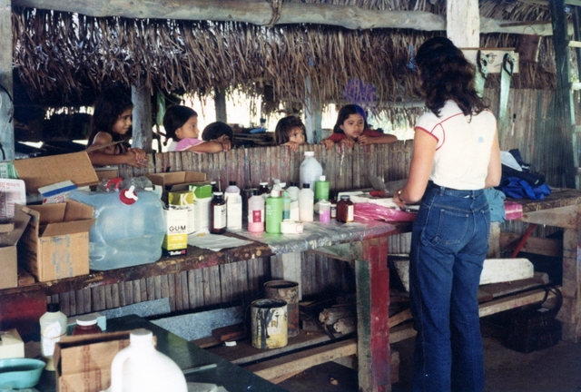
Off to
Punta Brava
Portable
pharmacy

Slide 17
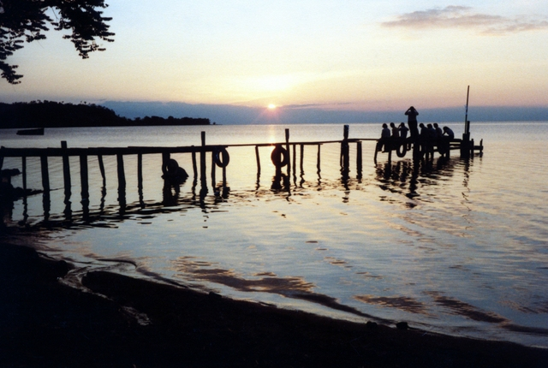
Notes:
Relaxing after long hot day

Slide 18
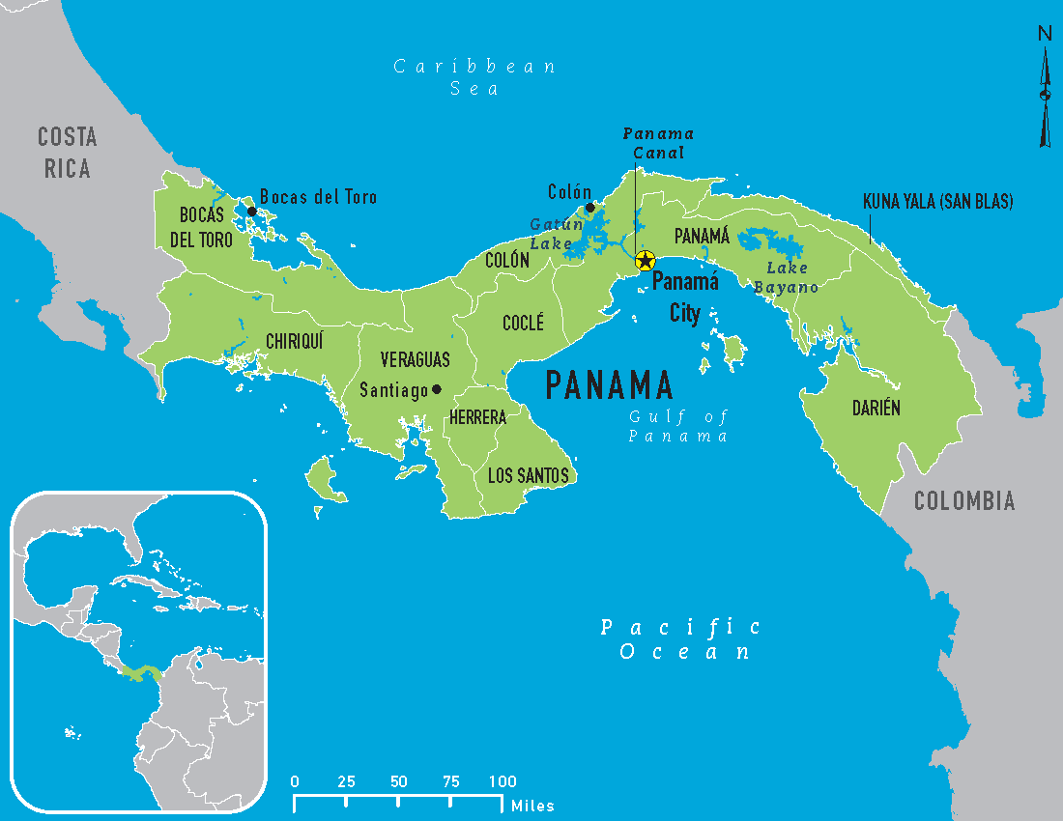
1982
.
Cusapin
Caribbean Methodist Church Clinic Cusapín on Valiente Peninsula
thecitydweller.me/perfect-weather-in-panama/
Notes:
Arrive Panana City, fly on to Bocas delToro and by cayuco to Cusapin. Caribbean Methodist Church
Clinic at Cusapin on Valiente Peninsula

Slide 19
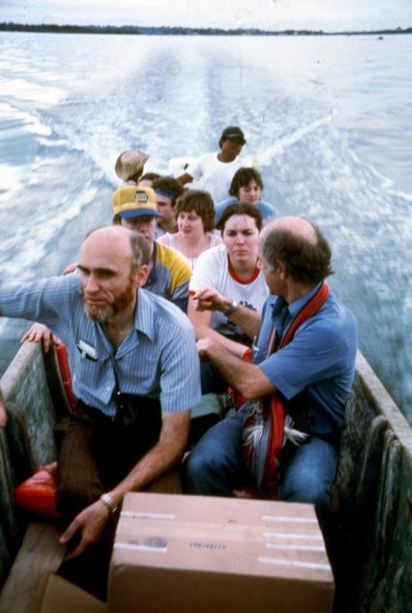
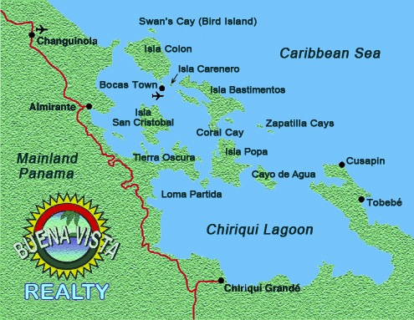
On the way to Cusapín
.bestbocasrealestate.com/map.html
Notes:
Left early evening, beautiful sunset, mirror calm sea, arrived after dark
Based at Cusapin and clinics at communities around the peninsula

Slide 20
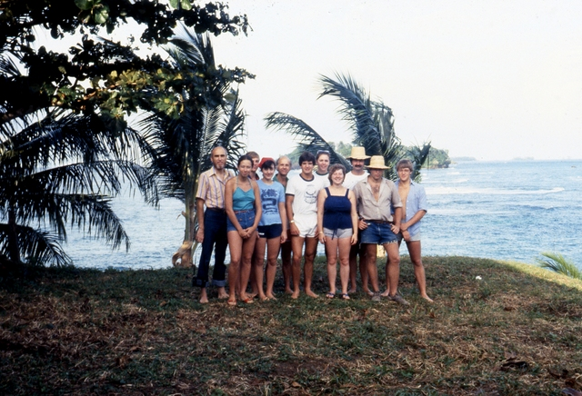
1982

Slide 21
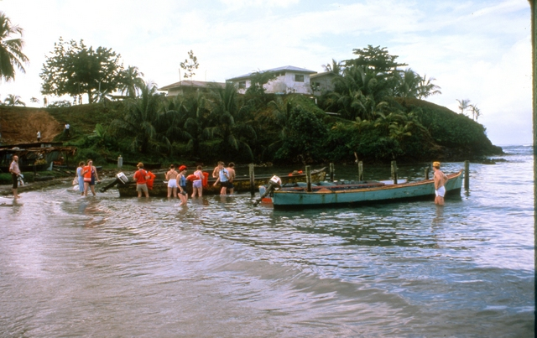
Packing for Playa Colorada

Slide 22
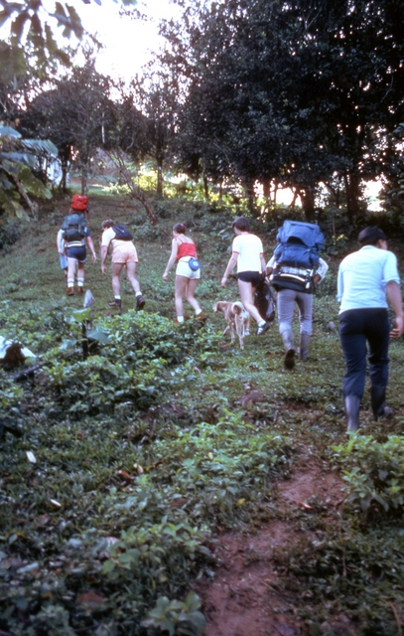
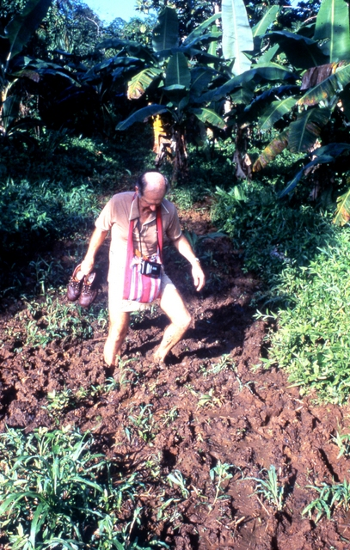
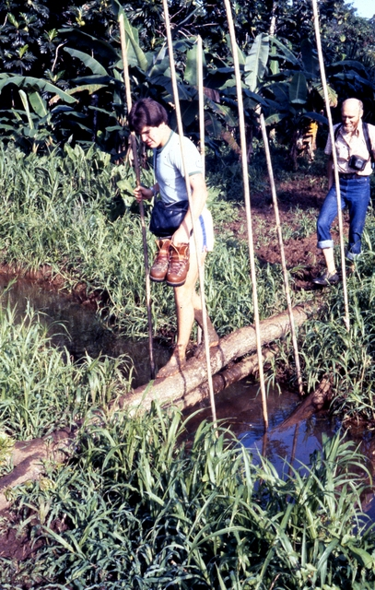
Hiking to Punta Uva
Notes:
Looked like an easy hike, but trail changed.

Slide 23
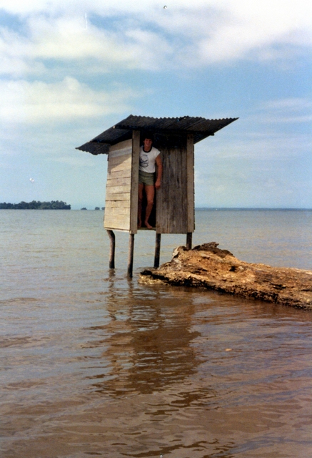
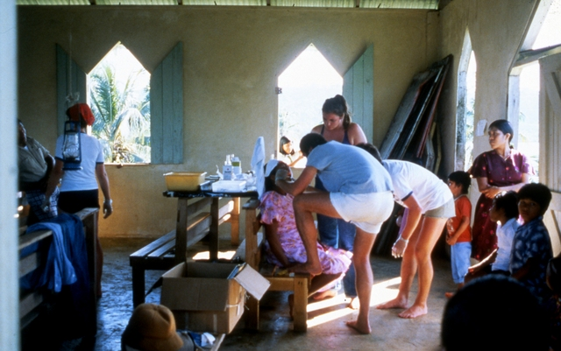
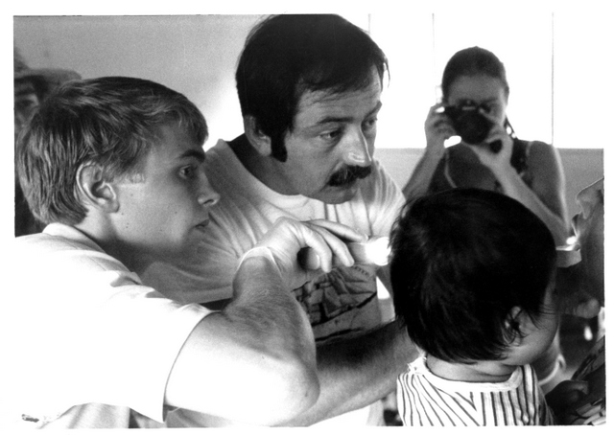
Clinic in a church
Bill Hankee, DDS
Notes:
Self flushing latrine.

Slide 24
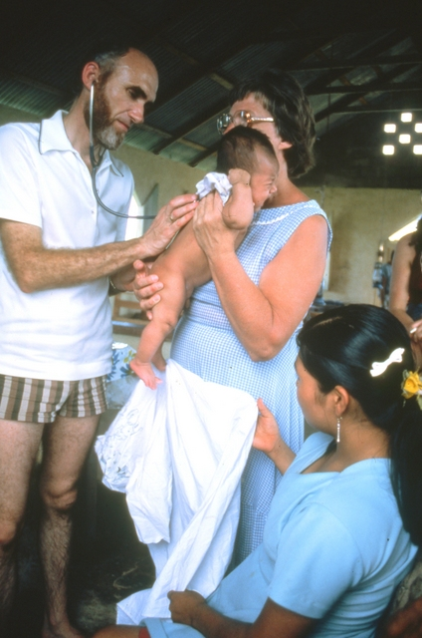
Dave Fouts,
MD, ‘56

Slide 25
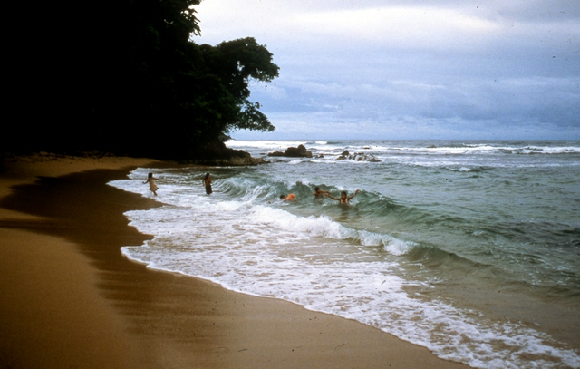
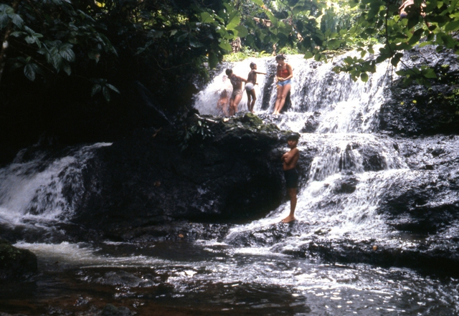
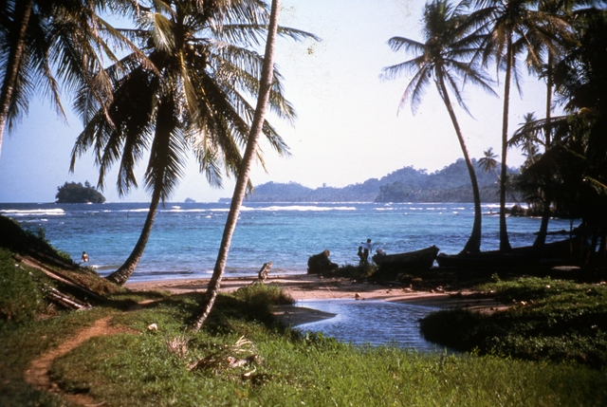
Weekend relaxation

Slide 26
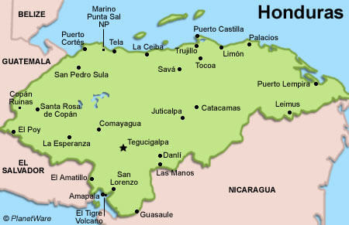
*
Omoa
planetware.com/
honduras-tourism-vacations-hon.htm
Notes:
Fly to San Pedro Sula, old US school bus to Puerto Cortes and Omoa. All clinics at Omoa, At end, train to Tela, for beach time, then back to SPS and day at Copan

Slide 27
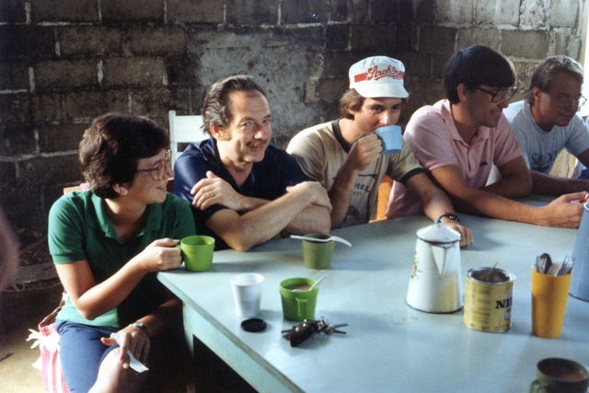
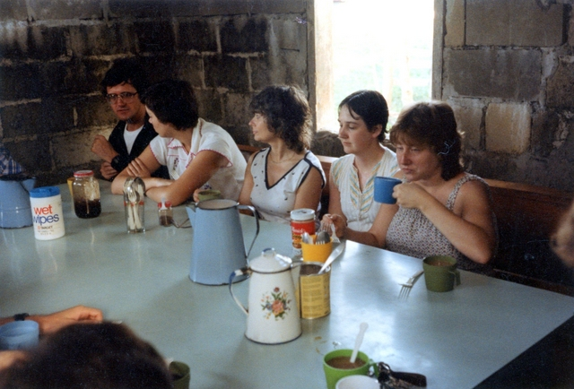
1983
Episcopal Parish Hall at Omoa

Slide 28
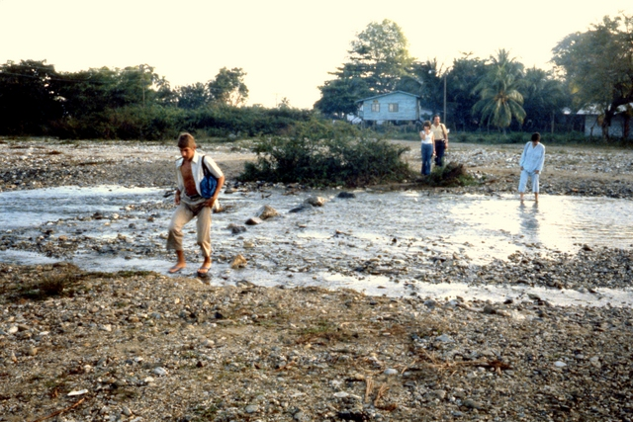
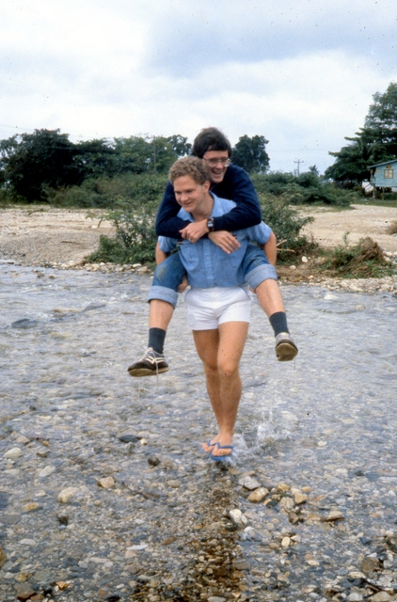
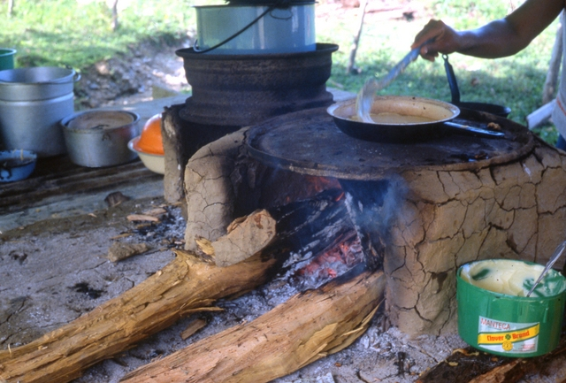
Notes:
Church, clinic and restrooms, showers on far side of stream, parish hall where we slept and ate on near side. Waded stream many times a day.

Slide 29
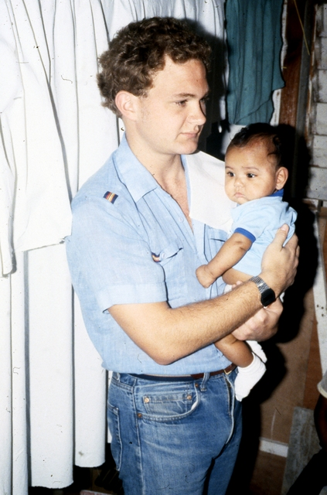
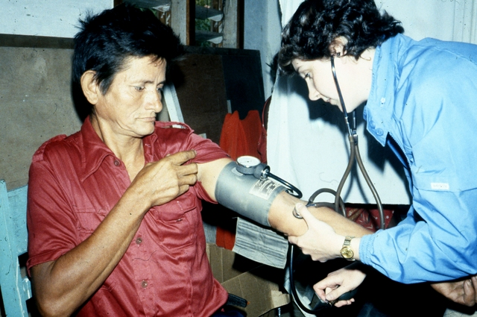

Slide 30
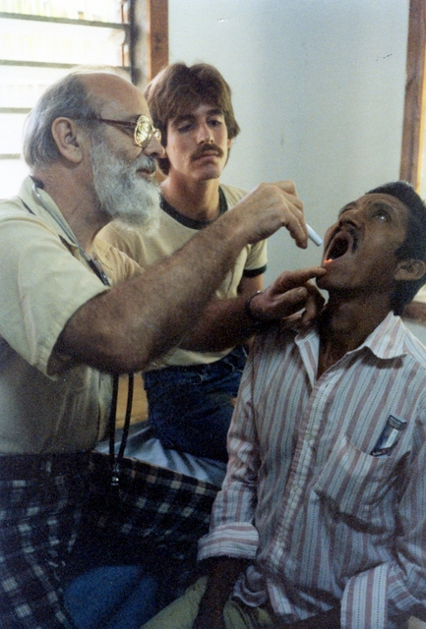
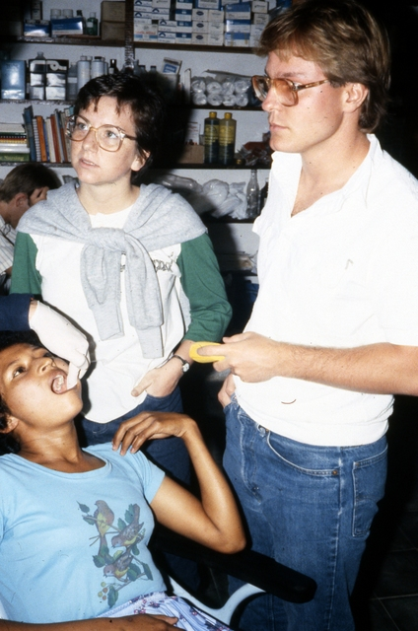
Lee Smith, MD, ‘47

Slide 31
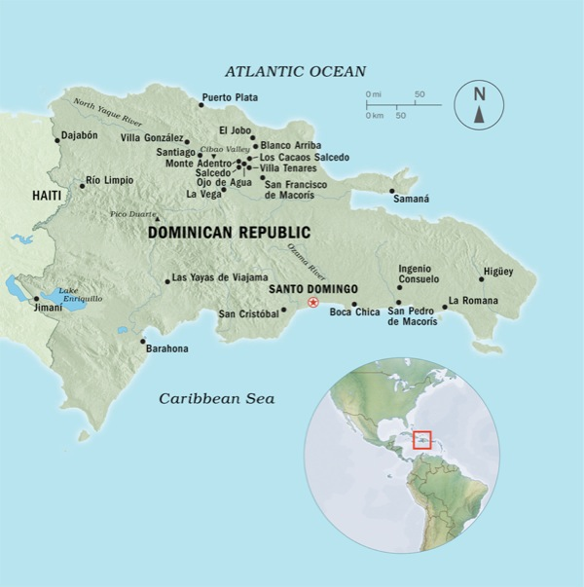
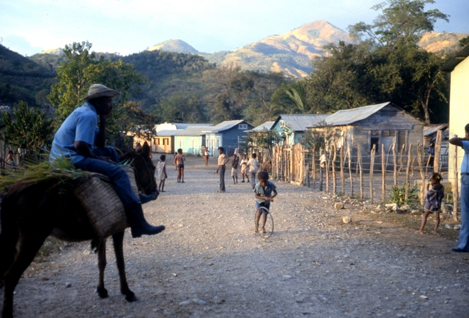
1984 and 1985
Viajama
*
Sosúa
*
*
http://wol.jw.org/en/wol/pc/r1/lp-e/1200271746/38/0
Notes:
Two Januaries in Viajama 1984 and 1985 Contact made through Karen Calderon at the Church of the Brethren Latin America Office
2 years at Viajama, 2 years at Boca Chica, Always R & R at Sosúa and fly from Puerto Plata

Slide 32
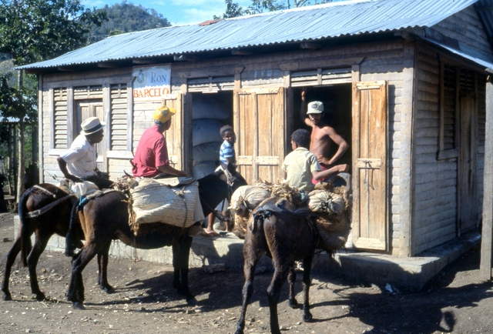

Slide 33

Notes:
Poorest, most primitive site we had served

Slide 34

Al fresco bathing

Slide 35

Yet another latrine

Slide 36



Dean Rust,
DDS, ‘68
Preparing Piperazine syrup
for treating lambrices
(round worms)

Slide 37



John Studebaker, MD, ‘68

Slide 38




Five Star Hotel and Restaurant in Viajama
R and R in Sosúa on North Coast

Slide 39

Boca Chica 1986, 1987
Notes:
Clinic at Hogar de Ancianas, run by nuns, located in very poor barrio

Slide 40


Vernon Rife, DDS, ‘69
Notes:
Many patients. Only time we had fully operating dental office and could do restorative work

Slide 41

*
*
Bonafacio
Jaco
www.lahistoriaconmapas.com
Notes:
Fly to San Jose and hosted be group in Cartago. Worked at Bonafacio, south of Limon, Poorest area of Costa Rica.

Slide 42

Bonafacio, Costa Rica 1988-90
Hosted by Misión Pentecostal Fé y Santidad
Notes:
Xmas eve phone call that they didn’t have permission, needed another signature. So much uncertainty. We took work gloves and tools for work camp if necessary.
Latrine at school where we stayed was full and overflowing, unusable, Constructed new 2 holer while waiting with Dr in charge of area. He was congenial and cooperative and clinics began

Slide 43


Public Health Project

Slide 44



Slide 45

Notes:
Showing off physiques after construction project

Slide 46



Notes:
Villages were along the RR track and we rode train several miles with supplies, worked the day and rode home, (if the train came)

Slide 47



Keim Houser, MD, ‘61
Mike Kastner, DDS, ‘77

Slide 48




Cahuita National Park
Volcán Poás, 8,885 ft
Cahuita

Slide 49

1993-2003
Mulukukú
2001
El Hormiguero
Nicaragua
El Hormiguero
*
.
Rio Blanco
www.lahistoriaconmapas.com
Notes:
Worked with the Maria Luisa Ortez Women’s Cooperative. Contact made by Julie Garber.
No clinic facility when we arrived. Lived in and worked in school. Adventure in just getting there.
Were able to observe great progress in health care and facilities.

Slide 50


Charcos Grandes

Slide 51



Slide 52



Slide 53


Slide 54



Slide 55



Notes:
Over whelmed by the need for health care
The cafeteria where our food was prepared and served. A surprise to find we had showers with running water.

Slide 56


Harriet Hamer, MD, ‘80

Slide 57


A “real”
ambulance derived from the Latin ambulare:
“to walk”
Chad Ringley, MD, ‘94

Slide 58


“Todo el mundo sabe.”
Elaine Shafer, MD, ‘89
Notes:
Indigenous princess from Prinzapolka region. She and mother traveled several days by walking, canoe, horseback and bus. We asked “How did you know we are here” She said: “The whole world knows”.
A number of times women came in to give birth.

Slide 59



Kathy Long, MD, ‘71

Slide 60

El Hormiguero 2001
Notes:
We went to El Hormiguero because the gov closed the clinic in MLKK due to a personal spat between coop leader and a gov. official. Clinic accused of performing abortions, totally illegal in Nicaragua. Not true.
Whole support group moved to EH with us: cooks, laundry workers. Coop helpers, etc

Slide 61


Lois Johnson, MD, ‘52

Slide 62

Archie Beckner, Daniel Ortega, Warren Hickman, Bill Weybright
DDS ’57 Pres. Nicaragua RPh, ’65 MD, ‘60

Slide 63

Warren Hickman, RPh, ‘65

Slide 64

Archie Beckner, DDS, ‘57

Slide 65


1993
1996

Slide 66

1995

Slide 67

Santa Maria, Nicaragua 2004-06
Notes:
After Mulukuku, we worked with the Ministry of Health to identify a clinic location where our help could be useful. We were in Santa Maria for three years, in the north west corner of Nicaragua, working in a local clinic run by the Silais, the network of small clinics within the Ministry of Health. Julie Garber led the trips to Santa Maria.

Slide 68

Paul Fry-Miller, PA-C, ‘75

Slide 69

2008-09 Ciudad Antigua, Nicaragua
Mark Shafer, DDS, ’88
Notes:
After the needs in Santa Maria decreased visibly, we worked with MINSA to move our work to Ciudad Antigua, also in the northern and western part of the country. Jeff Osborne began leading trips at this point.

Slide 70

2010 Río Coco, Nicaragua
Notes:
The need in Ciudad Antigua was decreased on the second year. The community was also relatively accessible, with twice daily bus service. I’d heard about indigenous communities in along the Rio Coco (Coco River). I met with the Minister of Health two times to talk about locations. He said that the Rio Coco region had the most need in the country, but that it was the most difficult to access. He welcomed our transition to that region.
In 2010, there were only a couple nurses who traveled between the villages containing about 30,000 people.
Since communication with the region was so difficult, due to lack of phone service or roads, our first trip in 2010 was not organized nearly as well as initially thought. Consequently, we improvised constantly and this first group will always hold a special place in my memories for what they achieved. For example, arriving at one village and being shown the school where we were to stay, which was full of cows and cow manure and then having to find places for everyone to stay.

Slide 71

2010-11, 2013-16
Alto Wangki-Bocay
Alto Wangki-Bocay
X
Santa María
El Hormiguero
X
X
Ciudad Antigua
X
Mulukukú
Environ. Sci. Technol. 2015, 49, 3989−3996
Notes:
The correct name for the region is the Alto Wangki-Bocay, which is a special autonomous zone, much like an indian reservation in the U.S., in which the indigenous people have considerable autonomy and deal directly with the federal government. The Alto Wangki-Bocay officially obtained autonomous status in 2008, with the practical autonomy actually functioning beginning around 2012.
Rio Coco and Rio Bocay
Near El Hormiguero
Returned to earlier models of trip of going to communities via boat. Several days at each community, then moving everything on to other community.

Slide 72

Walakitang
Mayangna
Moskito
~300 miles
San Andrés
Amak
Yakalpananí
Somotignes
Wisu
Winah
Notes:
We’ve gone to all of these communities since 2010, typically two per year, slowly developing relationships and making contacts with community leaders.
There were almost no wheels. Everything was carried.
Double translation became very common, involving English/Spanish and Spanish/Mayangna or Spanish/Moskito..
72

Slide 73

Loading Boats
Notes:
There are no roads into the Alto Wangki-Bocay. Where the road ends, we get into motorized dugout canoes.

Slide 74

2015
Notes:
We now take six motorized dugout canoes, the largest of which can hold up to 10,000 lbs.

Slide 75

2016
Notes:
Moving our several thousand pounds of clinic supplies and non-clinic supplies requires lots of teamwork.
We do eat the food local women prepare for us, so we do not carry much food at all.

Slide 76

Hauling Cargo
Notes:
Participants (2010 and 2011) will remember the ½ mile hike to the bottom of the hill in Walakitang…

Slide 77

Walakitang
2010, 2011
Notes:
…and then up this hill. The health clinic is beside the church on this hill. People who carried bags the ½ mile to the hill and then up the hill remember it.

Slide 78

Water Purification
Notes:
We purify our water, including river water. Illness is generally about the same as it was in Ciudad Antigua. This water is probably as good or better than bottled water.

Slide 79

Notes:
Hammocks with integrated mosquito nets have become standard, now. Often the hammocks have to be hung so close that when one person moves the neighboring ones start swinging, too.

Slide 80

Bill Fike, M.D.

Slide 81
Medical Practicum Evolution
Notes:
How the Medical Practicum has evolved over 35 years
Comparison of the 1981 and 2016 trips. Some things have stayed the same, but some things have changed.

Slide 82

1981
Notes:
The whole group loading the boat on the first trip.

Slide 83

2016
Notes:
Our group in the boats on a recent trip (2014, actually, but representative of current trips).

Slide 84
1981 2016
Students 8 16
Professionals 3 12
Patients
Dental 188 135
Medical 557 1731
Total 745 1866
Notes:
For 2017, 18 students, the largest ever.
In 2016, we had a dentist for a little over half the time. It’s difficult to find dentists.
For 2017, we will also have the first provider who was a student participant on one of Jeff’s trips.

Slide 85

62 at Meals
Notes:
The group size has increased. This last year we had 62 people at each meal, including students, US professionals, translators, Nicaraguan assistants, boatmen, and Nicaraguan health professionals. Eating together has definitely improved relationships with the locals. We at least see each other and have opportunities to interact at meals three times a day. It helps to build relationships and the emphasize that we are working together. Plus, the food is really good and plentiful.

Slide 86
Local Partners
Churches – 10 years
Guatemala, Panama, Honduras, D.R., Costa Rica
Social/Political Organization – 10 years
Nicaragua (Women’s Co-op in Mulukukú)
Federal Government – 11 years
(Santa María, Ciudad Antigua, Alto Wangki- Bocay)

Slide 87

Vaccinations
Notes:
A constant has been the local health care providers vaccinating those who come to be seen by us.
Last year, for example, 946 people were vaccinated. Our students join in helping, too.
The Nicaraguan government does have a remarkably good vaccination program, with coverage in the Alto Wangi-Bocay probably better than in Wabash County (although Wabash County has a relatively poor vaccination coverage due to so many people opting out).

Slide 88


Cryotherapy
  Jeff Easley, MD, MC ’83
  Rhonda Whitten, NP/midwife
Notes:
Women’s Health
Since Pap smear results can take 45 days to return to the clinic location in the Alto Wangki-Bocay, we adopted a “see and treat” method recommended by the WHO for regions with difficult Pap smear logistics. Putting white vinegar on the cervix causes possible pre-cancerous lesions to show up as white areas (“acetowhite”) within seconds. We can then freeze the white areas to kill the possible pre-cancerous lesions and thus prevent cervical cancer. Freezing is accomplished with CO2 gas expanding in a freezing wand. A patient can be screened and treated within a total of 20 minutes. We were the first group to do this cryotherapy in the Alto Wangki-Bocay.

Slide 89

Lab
  Urine analysis Glucose HbA1C
  Pregnancy Hemoglobin Chagas
  H. pylori Chlamydia Gonorrhea
Notes:
The development of rapid, portable, simple to use testing technologies has enabled us to expand our lab testing capabilities quite a bit, with two students performing tests all day each clinic day. Most require a smear or a drop of blood for analysis. The results from our screens through lab testing have allowed us to provide information to MINSA so that they can better use their limited resources. These lab tests have added considerable cost to our medicines and medical supplies, though.

Slide 90


Veterinarians
Emilie Blough, DVM MC ‘02
Notes:
We had along veterinarians for the first time in 2013, 2014, and 2015. They performed deworming, minor surgery, census of animals. We are now have agricultural specialists (farmers) going along with us to work with the local agricultural specialists in these villages to help discuss, educate, identify, and implement possible better practices (eg., goats are much more suited than cows, so talking is with Heifer International about goats for the region).

Slide 91
“Frequent Fliers”
8 Mark Shafer,DDS ’89
Bette Cowan, RN
9 Lois Johnson, MD ‘52
Don Parker, MD ‘56
Kathy Long, MD ‘71
Paul Fry-Miller, PA-C ’75
10 Bill Fike, MD
Notes:
120 different healthcare providers from U.S. have participated in total

Slide 92

Continuous Medical Practicum Spirit
Solidarity with local people.
Relationships with communities.
Accompanying local people in the work of health care.
Notes:
I’ve been back to Nicaragua about every other summer to build/strengthen relationships and the talk about the next trip and upcoming trips.
Translators are part of our group. Eating together and having evening talks together is important, too.

Slide 93

"If you have come here to help me, you are wasting your time. But if you have come because your liberation is bound up with mine, then let us work together." - Lilla Watson
Notes:
As more and more groups are doing medical mission trips, 27% of medical students participated in international medical mission trip (AMA Journal of Ethics Virtual Mentor. December 2006, Volume 8, Number 12: 797-800), the discussion about and push to keep high standards has been significant.

Slide 94

Outcomes
2016

Slide 95
Total Clinic Outcomes
39,581 medical consultations
5,259 dental patients
$213,463 meds/clinic supplies
677 lab tests (since 2013)
1,500 animals dewormed (since 2013)
Notes:
Tens of thousands of dollars’ worth of medicines and supplies acquired through direct donation.
Thousands of vaccinated individuals

Slide 96
Other Outcomes
Participants:
356 students
120 healthcare providers
65 other staff
48% students now in health care:
104 physicians
19 dentists
19 nurses
15 pharmacists
7 PAs

Slide 97
The Medical Practicum increased my…
-knowledge of other cultures, including their beliefs, values, perspectives, practices, and products.
84%
-understanding of global issues. 72%
Notes:
In May 2016, we performed a survey of MU alumni who had participated in the Medical Practicum, in an attempt to quantify long term effects from the trip. Everyone comes back saying that the trip “changed my life” or something similar, but we wanted to try and see if it actually did have a quantifiable effect over the course of participants’ lives. The data are not incredibly strong due to n=64, but they do indicate some positive, self-reported influences.
understanding of global issues. 72% strongly agree (n=64)
knowledge of other cultures, including their beliefs, values, perspectives, practices, and products. 84% strongly agree (n=64)

Slide 98
The Medical Practicum helped me…
-accept cultural differences.
76%
-recognize that different perceptions and behaviors may be based on cultural differences.
75%
-experience being a minority and/or an outsider.
73%
Notes:
This percentage strongly agreed (out of around 64 respondents)

Slide 99
“Adventure is discomfort in retrospect.”
- Jim Adams
Notes:
Everyone does have so many anecdotes and stories and memories of the adventure, which is another lasting outcome.

Slide 100



Acknowledgements
Providers
Donors
Medicines and Supplies
Med. Pract. Endowment
In-Country Partners
Host Communities
Manchester Family Dentistry
Notes:
The trip does not happen without such amazing, generous providers, who not only pay their own way, but also take valuable time away from work.
Brotherhood Mutual has been our largest donor since 2010. Manchester Rotary has been a constant supporter. Dan Myers at Manchester Family Dentistry has donated almost all the dental supplies for the last number of years.
Accion Medica Cristiana in Nicaragua has been the source of almost all our medicines over the last number of trips. They’re a non-profit who sets up non-profit pharmacies around Nicaragua. The slight excess we pay for medicines and supplies through them allows them to pay for more of these non-profit pharmacies.
Of course, too, the host communities open up their lives to allow us the privilege of working with them.

Slide 101

Future
www.Medical Practicum.org
Notes:
Continue with Mayangna Nation in Nicaragua. Continuity of relationships with community is really important. Continue to work on the Bocay River for the foreseeable future.
Involve pharmacy school students. Fourth year pharmacy students need to do a community education rotation. Since we are lacking in our community health education component, incorporating a couple fourth year pharmacy students each year will allow us to improve that aspect.
More permanent presence in Nicaragua, perhaps more than 3 weeks per year.
Other, international health care experiential learning opportunities for students. What else in international health care could involve MU students?

Slide 102
End

